Slide 1
Python Project (2020-2021)
Fr. Conceicao Rodrigues College of Engineering
Department of Computer Engineering
Ken Nunes 8892
Ross Lobo 8882
Reez Lobo 8914

Slide 2
title
→Online product scraping website with reviews,title,price&star rating.

Slide 3
Introduction :
The website will allow the user to select a particular product available online , the website will then display the price of the product from different e-commerce
The reviews of the product from different customers will also be shown .
The user will get an idea of the product , whether the product is worth buying or no .

Slide 4
HARDWARE/SOFTWARE:
Processors: Intel Atom® processor or Intel® Core™ i3 processor.
Disk space: 1 GB.
Operating systems: Windows* 7 or later, macOS, and Linux.
Python* versions: 2.7.X, 3.6.X.
A python IDE(VS-Code,Pychram)

Slide 5
Libraries used
Django==3.1.1
Requests
BeautifulSoup4
lxml

Slide 6
Technology
Web Scraping is done using beautiful soup .
The website is built using Django & Bootstrap.

Slide 7
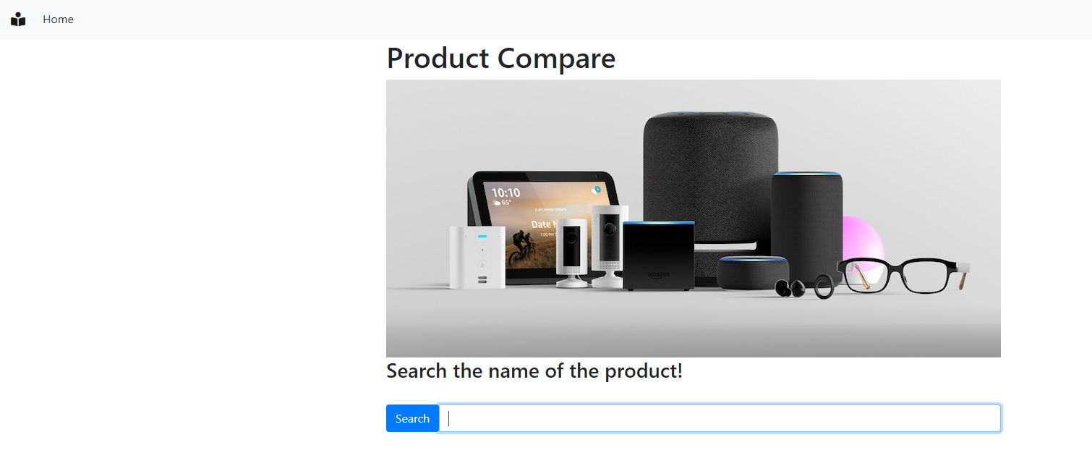
Input page

Slide 8
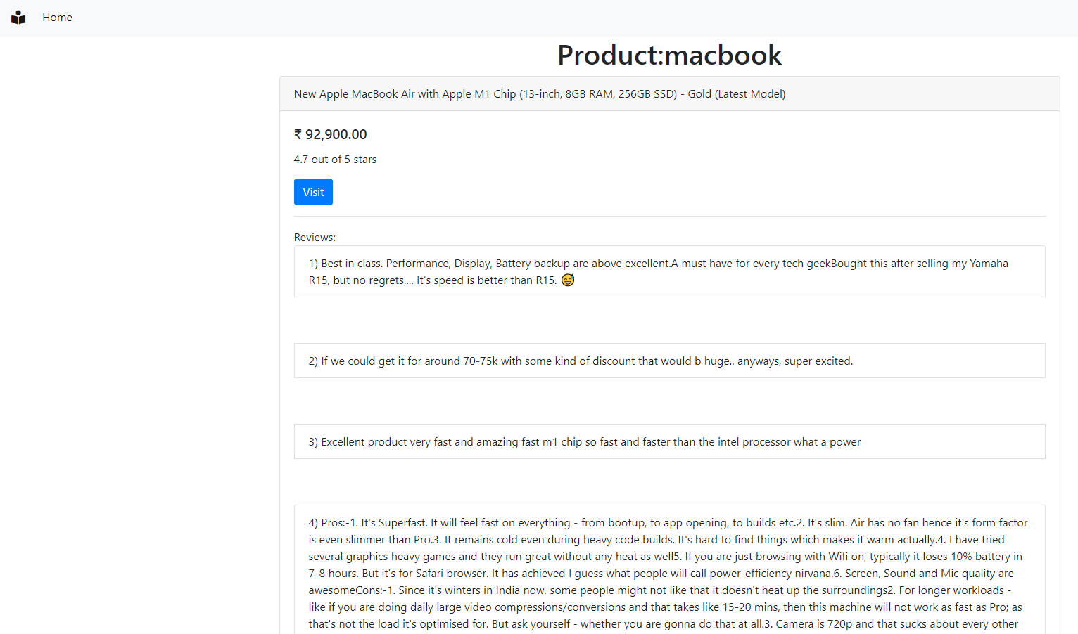
output

Slide 9
bibliography
https://www.youtube.com/watch?v=XVv6mJpFOb0
https://www.youtube.com/watch?v=F5mRW0jo-U4
https://towardsdatascience.com/learn-web-scraping-in-15-minutes-27e5ebb1c28e
https://medium.com/pythoneers/a-website-that-can-track-the-product-prices-of-amazon-and-flipkart-c0ab71f828a3

Slide 10
Thank You

